Slide 1
Chapter 4 Review

Slide 2
Important things to know
Sensations and perceptions
The physical and psychological properties of light and sound
Structures of the eye, especially the retina
Different kinds of photoreceptors
How we see color
How can light information be converted to neural activities?
How can sound information be converted to neural activities?
Encoding frequencies of sound: Place theory and frequency-matching theory

Slide 3
What is sensation?
When sensory information is detected by a sensory receptor, sensation has occurred.
Transduction: the conversion from environmental stimuli to neural activity

Slide 4
What is perception?
The way sensory information is organized, interpreted, and consciously experienced.
Bottom-up processing: perceive from sensory input
Top-down processing: interpretation of sensations is influenced by our knowledge, thoughts, and experiences

Slide 5
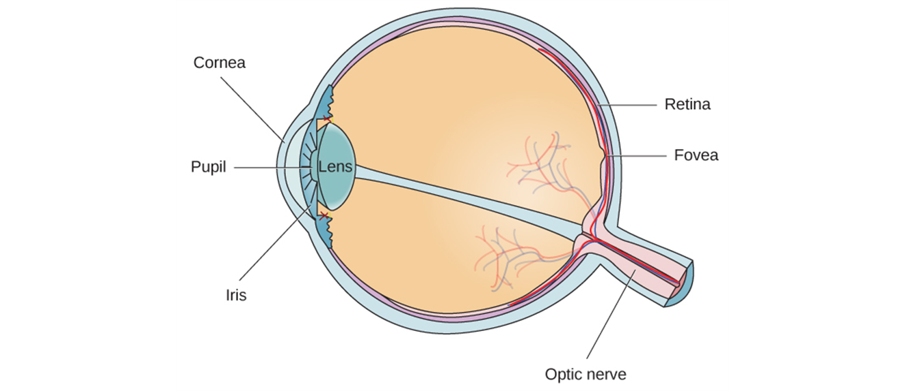
Major Structures of the Eye
Cornea
Protects the eye
Iris
Adjusts brightness
Pupil
Opening for light
Lens
Focuses light onto retina
Muscles
Change shape of lens to provide ocular accommodation
Retina
Transduces light into neural activity
Blind Spot
Where optic nerve leaves the retina

Slide 6
What specialized cells in our eyes convert light energy into neural activity?
Photoreceptors in the retina.
Two types of photoreceptors: Rods and cones.
Rods are light sensitive but not color sensitive; cones are color and detail sensitive.
Cones concentrate in the fovea, which is a region in the center of the retina.

Slide 7
What is trichromatic theory?
A theory about how we see color.
There are three types of visual elements in the eye, each of which is sensitive to different wavelengths, and that it is the combined responses of these three elements that produce the sensation of color.
Three types of cones: short-wavelength cones respond to blue, medium-wavelength respond to green, and long-wavelength respond to red

Slide 8

Opponent-Process Theory
Color-sensitive elements in the eye are grouped into three pairs, and the member of each pair inhibit.
Red-green elements, blue-yellow elements, and black-white elements.
When elements is no longer stimulated, the other element is activated.

Slide 9
Psychological dimension of sound
Loudness: determined by the amplitude of a sound wave
Pitch: determined by the frequency of a sound wave

Slide 10
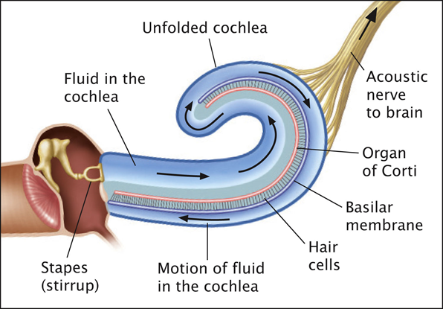
How is sound converted into neural activity?
This process happens in cochlea. Vibrations bend the hair cells on the basilar membrane of the cochlea, changing the membrane potential.
These hair cells in cochlea make connections with the fiber from the acoustic nerve.

Slide 11
How frequencies of sound are encoded?
Place theory: frequencies are coded by the location of the hair cells receiving the greatest stimulation. Different hair cells respond to different frequencies.
Temporal theory: frequencies are encoded by the combined firing rate of the neurons.

